Slide 1
STUDENTS SCORE ANALYSIS

Slide 2
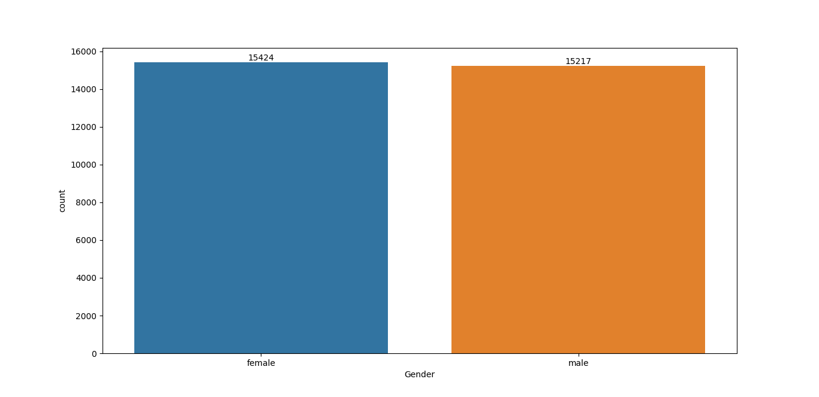
Gender Count
Female Gender count is more than male

Slide 3
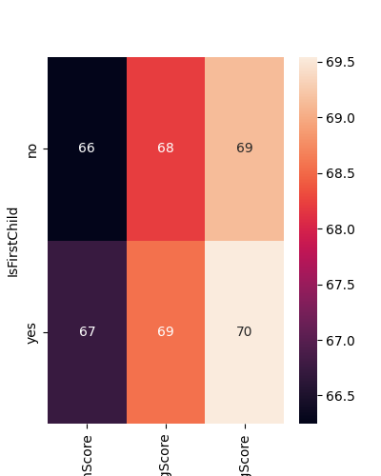
Analysis Based on first Child
First born children are performing better

Slide 4
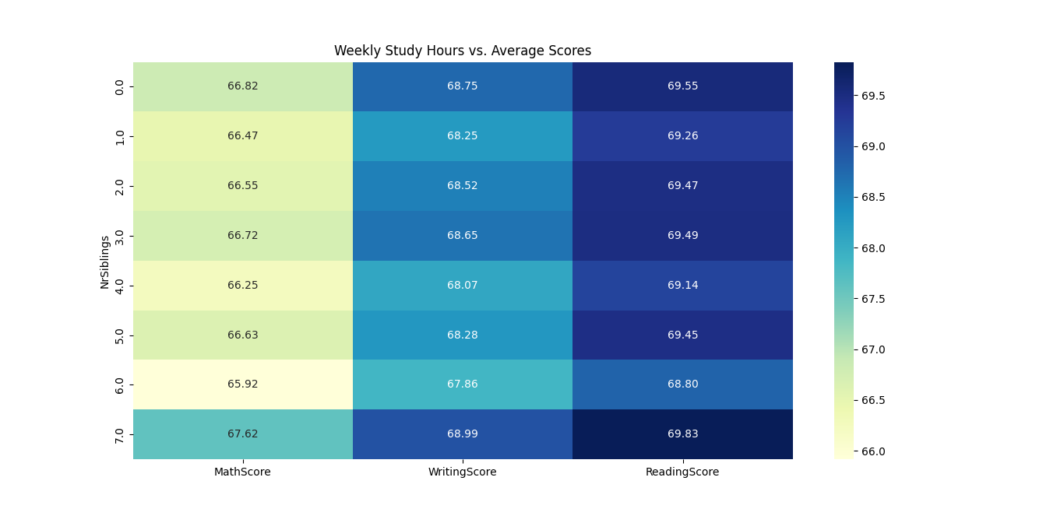
Analysis Based on Number of Siblings
Number of siblings has no significant impact on the score

Slide 5
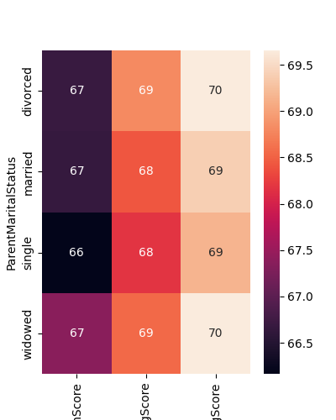
Analysis Based on Parent marital status
Parent marital status has no significant impact on the score

Slide 6
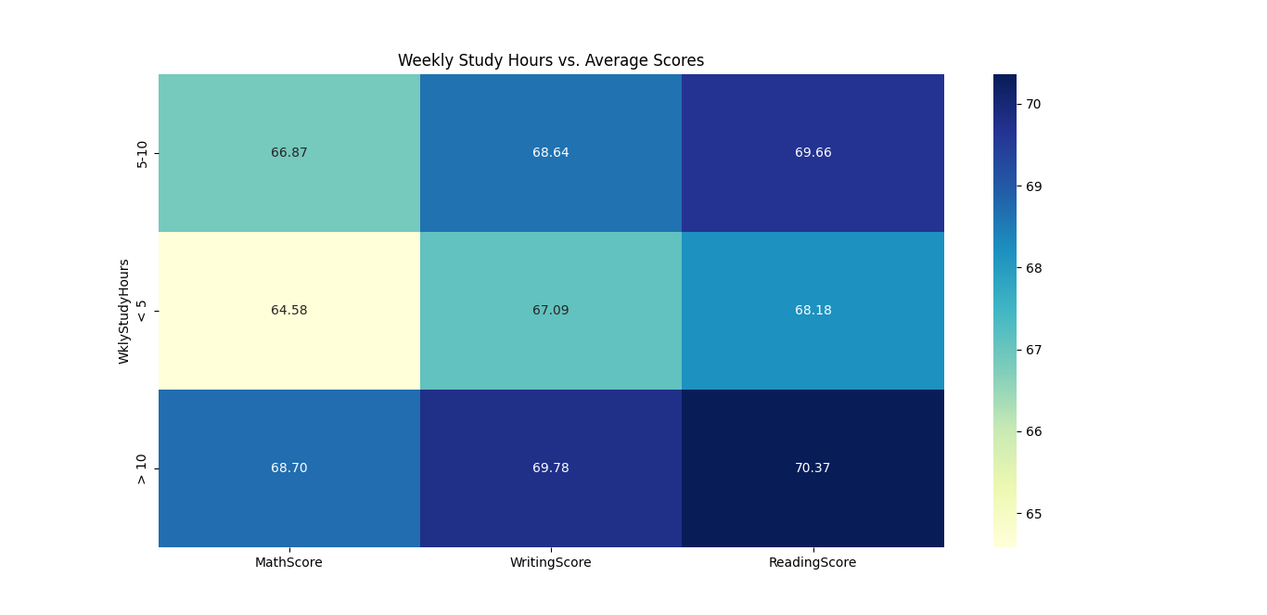
Analysis Based on study hours
Increase in the number of study hours has significant increase in score

Slide 7
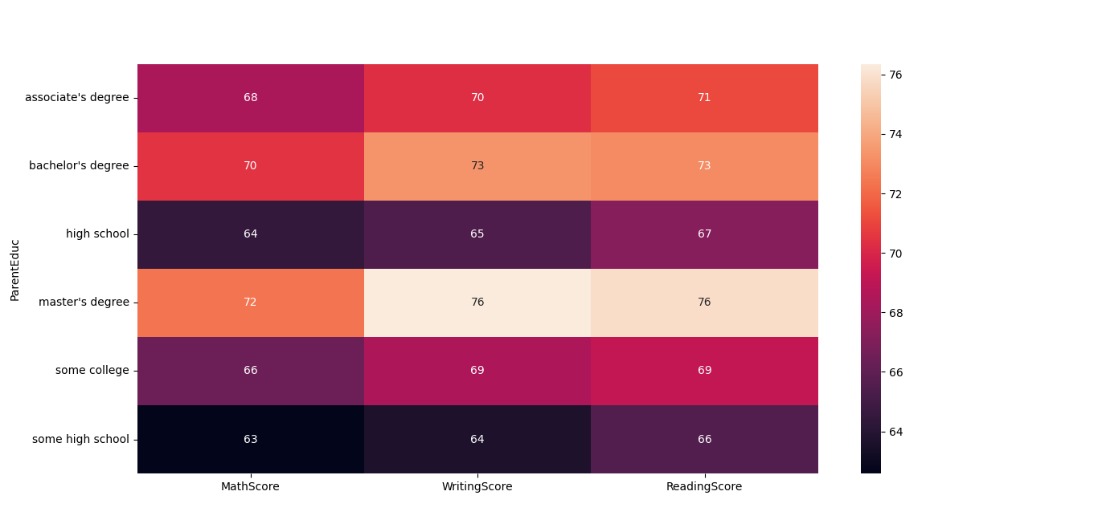
Analysis Based on Parent’s education
Parent’s higher education has significant increase in score of the student

Slide 8
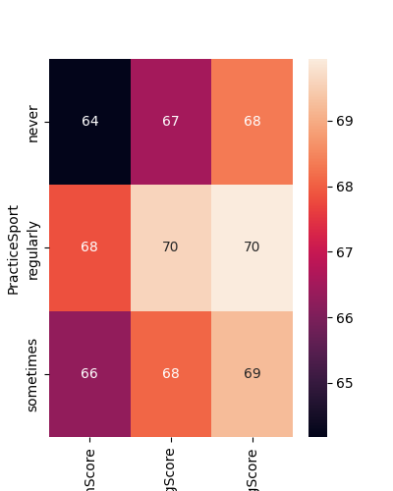
Analysis Based on Sports Practice
Regular sports practice has significant increase in score of the student

